Slide 1

PaRSEC: Parallel Runtime Scheduling and Execution Controller
Jack Dongarra, George Bosilca, Aurelien Bouteiller, Anthony Danalis, Mathieu Faverge, Thomas Herault
Also thanks to: Julien Herrmann, Julien Langou, Bradley R. Lowery, Yves Robert

Slide 2


Motivation
Today software developers face systems with
  ~1 TFLOP of compute power per node
  32+ of cores, 100+ hardware threads
  Highly heterogeneous architectures (cores + specialized cores + accelerators/coprocessors)
  Deep memory hierarchies
  Distributed systems
  Fast evolution
  Mainstream programming paradigms introduce systemic noise, load imbalance, overheads
    (< 70% peak on DLA)
Tianhe-2 China, June'14:
34 PetaFLOPS
Peak performance of 54.9 PFLOPS
  16,000 nodes contain 32,000 Xeon Ivy Bridge processors and 48,000 Xeon Phi accelerators totaling 3,120,000 cores
  162 cabinets in 720m² footprint
  Total 1.404 PB memory (88GB per node)
  Each Xeon Phi board utilizes 57 cores for aggregate 1.003 TFLOPS at 1.1GHz clock
  Proprietary TH Express-2 interconnect (fat tree with thirteen 576-port switches)
  12.4 PB parallel storage system
  17.6MW power consumption under load; 24MW including (water) cooling
  4096 SPARC V9 based Galaxy FT-1500 processors in front-end system

Slide 3
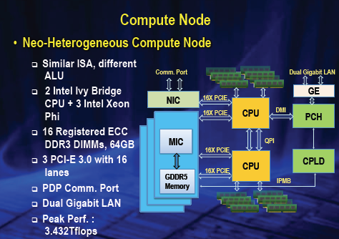
Task-based programming
Focus on data dependencies, data flows, and tasks
Don’t develop for an architecture but for a portability layer
Let the runtime deal with the hardware characteristics
  But provide as much user control as possible
StarSS, StarPU, Swift, Parallex, Quark, Kaapi, DuctTeip, ..., and PaRSEC
App
Data
Distrib.
Sched.
Comm
Runtime
Memory Manager
Heterogeneity Manager

Slide 4
The PaRSEC framework
Dense LA
…
Sparse LA
Chemistry
Domain Specific Extensions
Compact Representation - PTG
Dynamic / Prototyping Interface - DTD
Power User
Data
SpecializedKernels
Scheduling
Tasks
SpecializedKernels
Parallel Runtime
Scheduling
Tasks
Specialized Kernels
Scheduling
Tasks
Data Movement
Hardware
Memory Hierarchies
Data Movement
Accelerators
Cores
Coherence

Slide 5
PaRSEC toolchain
PaRSEC Toolchain

Slide 6
Input Format – Quark/StarPU/MORSE
Sequential C code
Annotated through some specific syntax
  Insert_Task
  INOUT, OUTPUT, INPUT
  REGION_L, REGION_U, REGION_D, …
  LOCALITY
for (k = 0; k < A.mt; k++) {
Insert_Task( zgeqrt, A[k][k], INOUT,
T[k][k], OUTPUT);
for (m = k+1; m < A.mt; m++) {
Insert_Task( ztsqrt, A[k][k], INOUT | REGION_D|REGION_U,
A[m][k], INOUT | LOCALITY,
T[m][k], OUTPUT);
}
for (n = k+1; n < A.nt; n++) {
Insert_Task( zunmqr, A[k][k], INPUT | REGION_L,
T[k][k], INPUT,
A[k][m], INOUT);
for (m = k+1; m < A.mt; m++)
Insert_Task( ztsmqr, A[k][n], INOUT,
A[m][n], INOUT | LOCALITY,
A[m][k], INPUT,
T[m][k], INPUT);
}
}

Slide 7
Example: QR Factorization (DLA)

Slide 8
Dataflow Analysis
data flow analysis
  Example on task DGEQRT of QR
  Polyhedral Analysis through Omega Test
  Compute algebraic expressions for:
    Source and destination tasks
    Necessary conditions for that data flow to exist

Slide 9
Intermediate Representation:
Job Data Flow
GEQRT(k)
/* Execution space */
k = 0..( MT < NT ) ? MT-1 : NT-1 )
/* Locality */
: A(k, k)
RW A <- (k == 0) ? A(k, k)
: A1 TSMQR(k-1, k, k)
-> (k < NT-1) ? A UNMQR(k, k+1 .. NT-1) [type = LOWER]
-> (k < MT-1) ? A1 TSQRT(k, k+1) [type = UPPER]
-> (k == MT-1) ? A(k, k) [type = UPPER]
WRITE T <- T(k, k)
-> T(k, k)
-> (k < NT-1) ? T UNMQR(k, k+1 .. NT-1)
/* Priority */
;(NT-k)*(NT-k)*(NT-k)
BODY [GPU, CPU, MIC]
zgeqrt( A, T )
END
Control flow is eliminated, therefore maximum parallelism is possible

Slide 10
Data/Task Distribution
Flexible data distribution
  Decoupled from the algorithm
  Expressed as a user-defined function
  Only limitation: must evaluate uniformly across all nodes
Common distributions provided in DSEs
  1D cyclic, 2D cyclic, etc.
  Symbol Matrix for sparse direct solvers

Slide 11
PaRSEC Runtime
Thread 0
^{Ta(0)}
S
^{Tb(0,0)}
S
^{Ta(6)}
S
^{Ta(8)}
S
^{Tb(0,1)}
Each computation thread alternates between executing a task and scheduling tasks
Computation threads are bound to cores
Communication threads (one per node) transfer task completion notifications, and data
Communication threads can be bound or not
Node 0
Thread 1
^{Ta(2)}
S
^{Tb(2,1)}
S
^{Ta(4)}
S
S
^{Ta(9)}
S
Comm.
Thread
^{N}
^{D}
^{N}
^{D}
^{N}
^{D}
Comm.
Thread
^{A}
^{A}
^{D}
S
^{A}
^{D D}
S
Node 1
Thread 1
^{Ta(1)}
S
^{Tb(0,2)}
S
^{Ta(5)}
S
^{Ta(9)}
S
Thread 0
^{Ta(3)}
S
^{Tb(1,2)}
S
^{Ta(7)}
S
^{Tb(2,2)}

Slide 12
Strong Scaling
≈ 270x270 double / core

Slide 13
PaRSEC Runtime: Accelerators
BODY [GPU, CPU, MIC]
zgeqrt( A, T )
END
Comp.
Accelerator 0
OUT
When tasks that can run on an accelerator are scheduled
  A computation thread takes control of a free accelerator
  Schedules tasks and data movements on the accelerator
  Until no more tasks can run on the accelerator
The engine takes care of the data consistency
  Multiple copies (with versioning) of each "tile" co-exist, on different resources
  Data Movement between devices is implicit
IN
S
S
S
S
Thread 0
^{Ta(0)}
S
Acc. Client
S
^{Tb(0,1)}
Node 0
Thread 1
^{Ta(2)}
S
^{Tb(2,1)}
S
S
^{Ta(4)}
S
S
^{Ta(6)}
S
Comm.
Thread
^{N}
^{D}
^{N}
^{D}
^{N}
^{D}

Slide 14
Multi GPU – single node
Multi GPU - distributed
Scalability
Single node
4xTesla (C1060)
16 cores (AMD opteron)
Keeneland
  64 nodes
    3 * M2090
    16 cores

Slide 15
Example 1: Hierarchical QR
A single QR step = nullify all tiles below the current diagonal tile
Choosing what tile to "kill" with what other tile defines the duration of the step
This coupling defines a Tree
Choosing how to compose trees depends on the shape of the matrix, on the cost of each kernel operation, on the platform characteristics
A Binomial Tree
A Flat Tree

Slide 16
Example 1: Hierarchical QR
A single QR step = nullify all tiles below the current diagonal tile
Choosing what tile to "kill" with what other tile defines the duration of the operation
This coupling defines a Tree
Choosing how to compose trees depends on the shape of the matrix, on the cost of each kernel operation, on the platform characteristics
Composing Two Binomial Trees

Slide 17
Example 1: Hierarchical QR
Sequential Algorithm
JDF Representation
qtree (passed as arbitrary structure to the JDF object) implements elim / killer as a set of convenient functions
zunmqr(k, i, n)
/* Execution space */
k = 0 .. minMN-1
i = 0 .. qrtree.getnbgeqrf( k ) - 1
n = k+1 .. NT-1
m = qrtree.getm(k, i)
nextm = qrtree.nextpiv(k, m, MT)
: A(m, n)
READ A <- A zgeqrt(k, i) [type = LOWER_TILE]
READ T <- T zgeqrt(k, i) [type = LITTLE_T]
RW C <- ( 0 == k ) ? A(m, n)
<- ( k > 0 ) ? A2 zttmqr(k-1, m, n)
-> ( k == MT-1) ? A(m, n)
-> ( k < MT-1) & (nextm != MT) ) ?
A1 zttmqr(k, nextm, n)
-> ( k < MT-1) & (nextm == MT) ) ?
A2 zttmqr(k, m, n)
depends on arbitrary functions killer(i, k) and elim(i, j, k)

Slide 18
Hierarchical QR
How to compose trees to get the best pipeline?
  Flat, Binary, Fibonacci,
  Greedy, …
Study on critical path lengths
Square -> Tall and Skinny
Surprisingly Flat trees are better for communications on square cases:
  Less communications
  Good pipeline

Slide 19
Hierarchical QR
How to compose trees to get the best pipeline?
  Flat, Binary, Fibonacci,
  Greedy, …
Study on critical path lengths
Square -> Tall and Skinny
Surprisingly Flat trees are better for communications on square cases:
  Less communications
  Good pipeline

Slide 20
Example 2: Hybrid LU-QR
Factorization A=LU
  where L unit lower triangular, U upper triangular
  floating point operations
Factorization A=QR
  where Q is orthogonal, and R upper triangular
  floating point operations
LUPP: Partial Pivoting involves many communications in the critical path
  Without Partial Pivoting: low numerical stability

Slide 21
Example 2: LU "Incremental" Pivoting

Slide 22
Example 2: QR

Slide 23
Example 2: LU/QR Hybrid Algorithm

Slide 24
Example 2: LU/QR Hybrid Algorithm
selector(k,m,n)
[...]
do_lu = lu_tab[k]
did_lu = (k == 0) ? -1 : lu_tab[k-1]
q = (n-k)%param_q
[...]
CTL ctl <- (q == 0) ? ctl setchoice(k, p, hmax)
<- (q != 0) ? ctl setchoice_update(k, p, q)
RW A <- ((k == n) && (k == m)) ? A zlufacto(k, 0)
<- ((k == n) && (k != m) && diagdom) ? B copypanel(k, m)
<- ((k == n) && (k != m) && !diagdom) ? A copypanel(k, m)
<- ((k != n) && (k == 0)) ? A(m, n)
<- ((k != n) && (k != 0) && (did_lu == 1)) ? C zgemm( k-1,m,n)
<- ((k != n) && (k != 0) && (did_lu != 1)) ? A2 zttmqr(k-1,m,n)
/* LU */
-> ( (do_lu == 1) && (k == n) && (k == m) ) ? A zgetrf(k)
-> ( (do_lu == 1) && (k == n) && (k != m) ) ? C ztrsm_l(k,m)
-> ( (do_lu == 1) && (k != n) && (k != m) && (!diagdom)) ? C zgemm(k,m,n)
/* QR */
-> ( (do_lu != 1) && (k == n) && (type != 0) ) ? A zgeqrt(k,i)
-> ( (do_lu != 1) && (k == n) && (type == 0) ) ? A2 zttqrt(k,m)
-> ( (do_lu != 1) && (k != n) && (type != 0) ) ? C zunmqr(k,i,n)
-> ( (do_lu != 1) && (k != n) && (type == 0) ) ? A2 zttmqr(k,m,n)

Slide 25
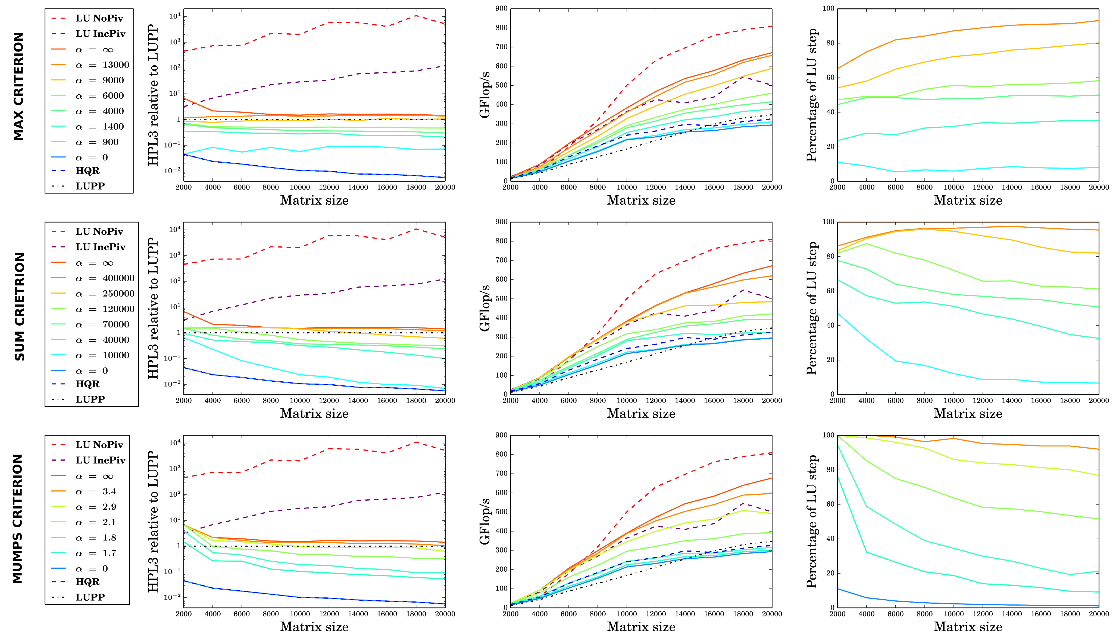
Hybrid LU/QR Performance

Slide 26
Conclusion
Programming made easy(ier)
  Portability: inherently take advantage of all hardware capabilities
  Efficiency: deliver the best performance on several families of algorithms
Build a scientific enabler allowing different communities to focus on
different problems
  Application developers on their algorithms
  Language specialists on Domain Specific Languages
  System developers on system issues
  Compilers on whatever they can
Dense LA
…
Sparse LA
Chemistry
Domain Specific Extensions
Compact Representation - PTG
Dynamic Discovered Representation - DTG
Hardcore
Data
SpecializedKernels
Scheduling
Tasks
SpecializedKernels
Parallel Runtime
Scheduling
Tasks
Specialized Kernels
Scheduling
Tasks
Data Movement
Hardware
Memory Hierarchies
Data Movement
Accelerators
Cores
Coherence

